Slide 1

SHOPPING DASH BOARD
Keerthana Kothoju
Data science student
kothojukeerthana@gmail.com

Slide 2
Intro
Task 4: Dashboard Design Objective: Design an interactive dashboard for business stakeholders.
Tools: Power BI / Tableau Deliverables: Interactive Dashboard + PPT summary a. Hints/Mini Guide:
Choose right KPIs (Sales, Profit, Growth) .
Use slicers/filters for interactivity Include time-series analysis Add cards for totals/summary
Apply consistent color theme Create navigation menu (if possible)
Dataset: Any Sales_Financial dataset (from kaggle) Outcome: Learn how to create dashboards that inform business decisions.

Slide 3
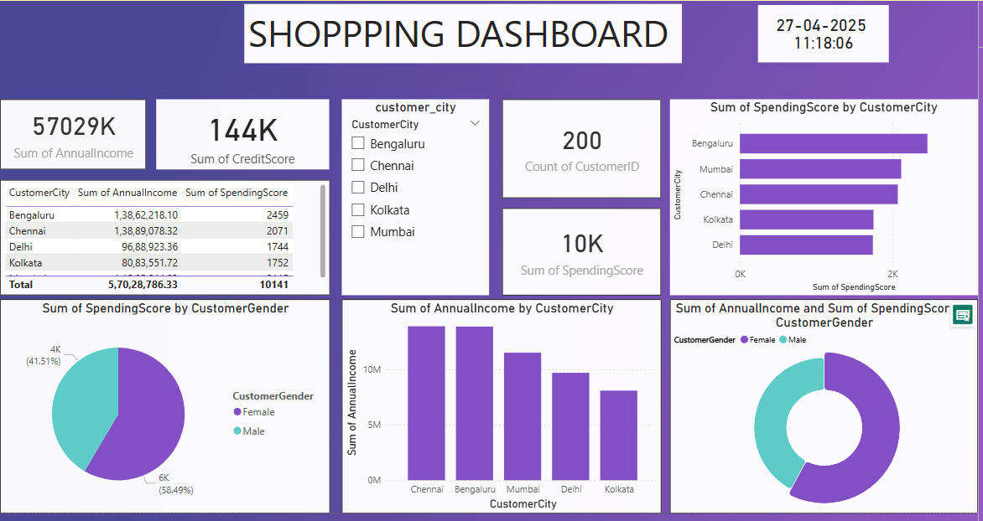

Slide 4
Summary on Dashboard
Key Highlights:
Total Annual Income: ₹5.70Crores
Total Credit Score: 144K
Total Customers: 200
Total Spending Score: 10K

Slide 5
City-Wise Insights:
Top Annual Income Cities:
Chennai (~₹1.39 Crores)
Bengaluru (~₹1.38 Crores)
Top Spending Cities:
Bengaluru (2459)
Mumbai (~close to Chennai)

Slide 6
Gender-Wise Insights:
Spending Score Distribution:
Male: 58.49%
Female: 41.51%
Income & Spending:
Males contribute slightly more towards both annual income and spending scores.

Slide 7
Visual Highlights:
Bar Charts: Display spending and income across cities.
Pie Charts: Show gender distribution clearly.
Dropdown Filter: Allows selection of specific cities for focused analysis.
Real-time Clock: Dashboard shows the live date and time.

Slide 8
